Slide 1

OPERATION SEQUENCE FOR 500kV BUS BAR -1 MAINTENANCE

Slide 2
Considerations Before the Operation:
We can see that when we shutdown 500kV BB-1 there will be no effect on all outgoing 500kV lines and power transmission will not be effected.
The only load which will be affected is 500/35kV T-3 station transformer and its corresponding load of SPC.
So first the load should be shifted from 35kV #1M to 132/11kV T-7 transformer.

Slide 3
Circuit Breaker Open Operation Procedure:
Operator will give command from the OWS.
Person in the yard will confirm that all three phases of CB are indeed open by checking the indicator on all three phases.
OWS operator will also confirm that the indication on OWS after the operation is right.

Slide 4
Isolator Open Operation Procedure:
Person in the yard will switch on the control and motor power MCB of the isolator from B-phase isolator box.
OWS operator will confirm that the control and motor power for the isolator is indeed restored.
OWS operator will give the command of opening the isolator from OWS.
Person in the yard check that all three phase of isolator are indeed open.
OWS operator will confirm that the indication at OWS screen is correct.
After the operation is complete the person in the yard will switch off the control and motor power MCB of the isolator.
OWS operator will confirm that control and motor power of the isolator is indeed switched off.

Slide 5
Earth Switch Closing Operation Procedure:
Person in the yard will switch on the control and motor power MCB of the earth switch from B-phase earth switch box.
OWS operator will confirm that the control and motor power for the earth switch is indeed restored.
OWS operator will give the command of closing the earth switch from OWS.
Person in the yard check that all three phase of earth switch are indeed close.
OWS operator will confirm that the indication at OWS screen is correct.
After the operation is complete the person in the yard will switch off the control and motor power MCB of the earth switch.
OWS operator will confirm that control and motor power of the earth switch is indeed switched off.

Slide 6
35kV #1M Operation:
We will open 35/11kV T-5 transformer HV Side circuit breaker H3Q1.
As the 35kV #1M bus lose power the 11kV CB 101 will open and the 11kV BB-1 and 11kV BB-3 coupler breaker 141 will be closed automatically.
Now the load of 11kV BB-1 is been charged from 11kV BB-3 which is getting power from 132/11kV T-7 transformer.
Now we will shift the control of shunt reactor SR-1 and SR-2 from auto to manual.
If the SR-1 and SR-2 in operation we have to open the circuit breaker H1Q1 and H2Q1 in order to convert them from operation to hot standby.

Slide 7
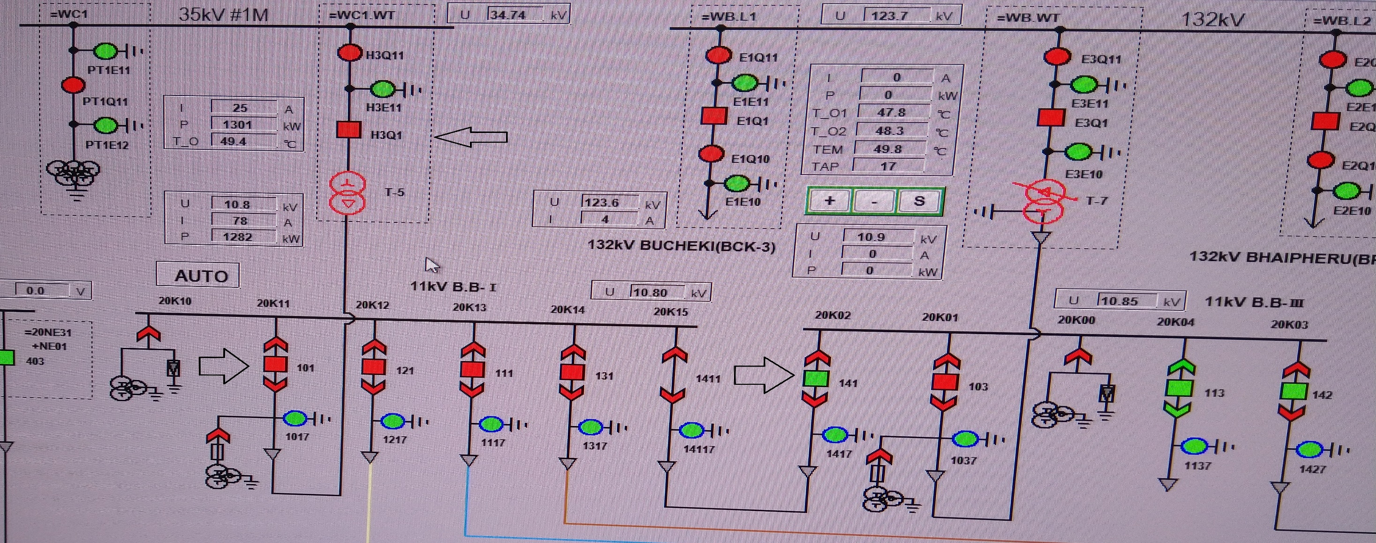
35kV #1M Operation:

Slide 8
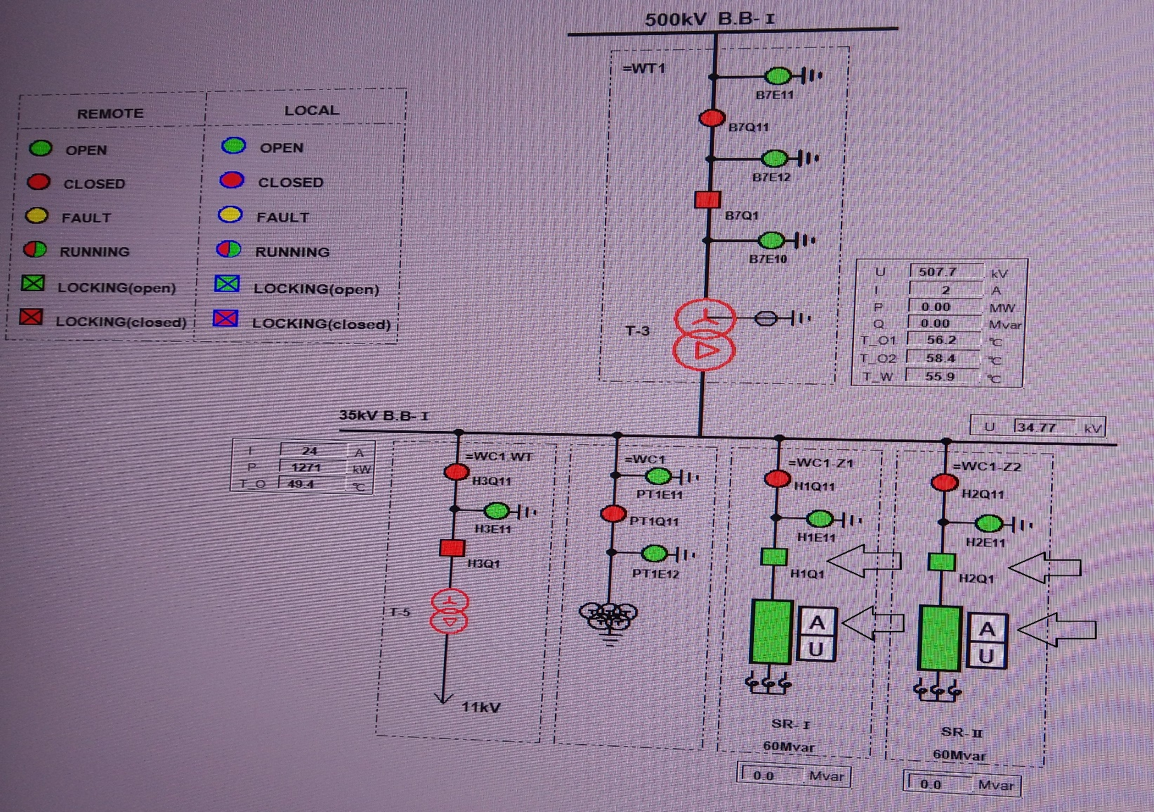
35kV #1M Operation:

Slide 9
500/35kV T-3 Station Transformer HV Side Operation:
Now open the Q1 CB of all the bays to convert the BB-1 from operation to hot standby state.
Opening sequence of Q1 CB will be: B7Q1, B2Q1, B3Q1, B5Q1, B6Q1 and B1Q1.

Slide 10
35kV #1M Operation:
Now open 35/11kV T-5 transformer HV side isolator H3Q11.
Also open SR-1 and SR-2 isolators H1Q11 and H2Q11 respectively.
Interlocking conditioning for isolator opening is that the corresponding circuit breaker should be open as the isolator is off load device.
Also the 35kV #1M bus PT secondary circuit MCB should be opened.

Slide 11
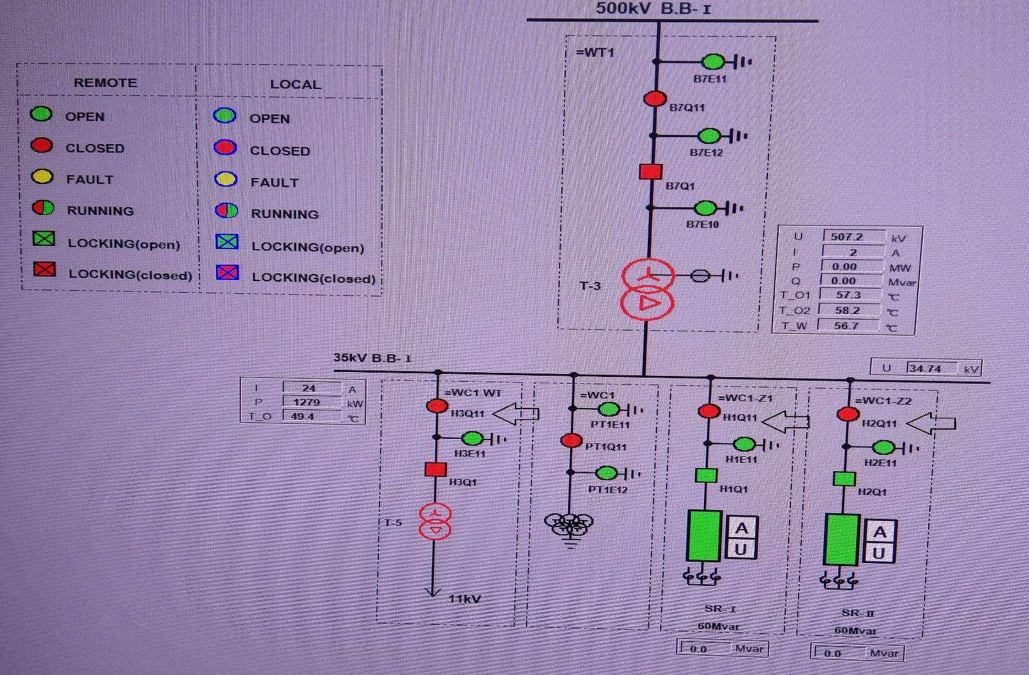
35kV #1M Operation:

Slide 12
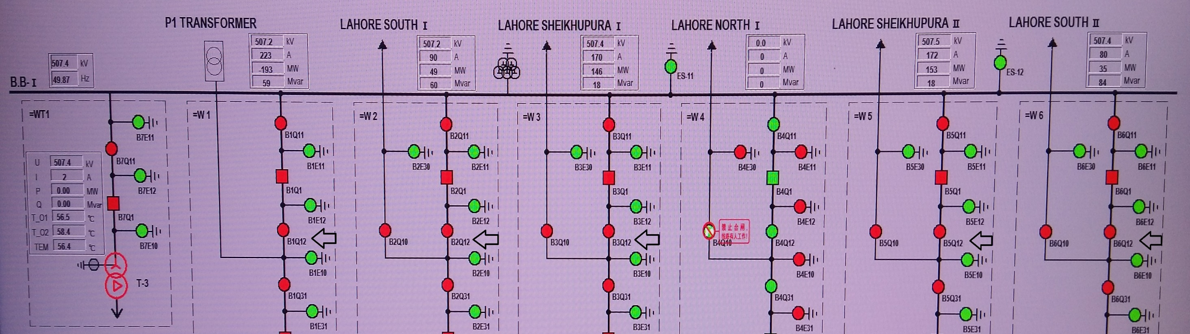
500kV BB-1 Operation:
Now open CB Q1 Line side isolators Q12. Interlocking condition for opening of isolators is that corresponding CB should be open.

Slide 13
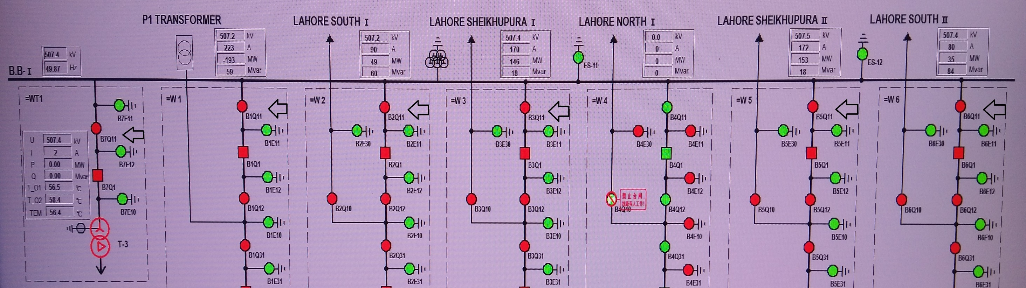
500kV BB-1 Operation:
Now open CB Q1 Bus side isolators Q11. Interlocking condition for opening of isolators is that corresponding CB should be open.

Slide 14
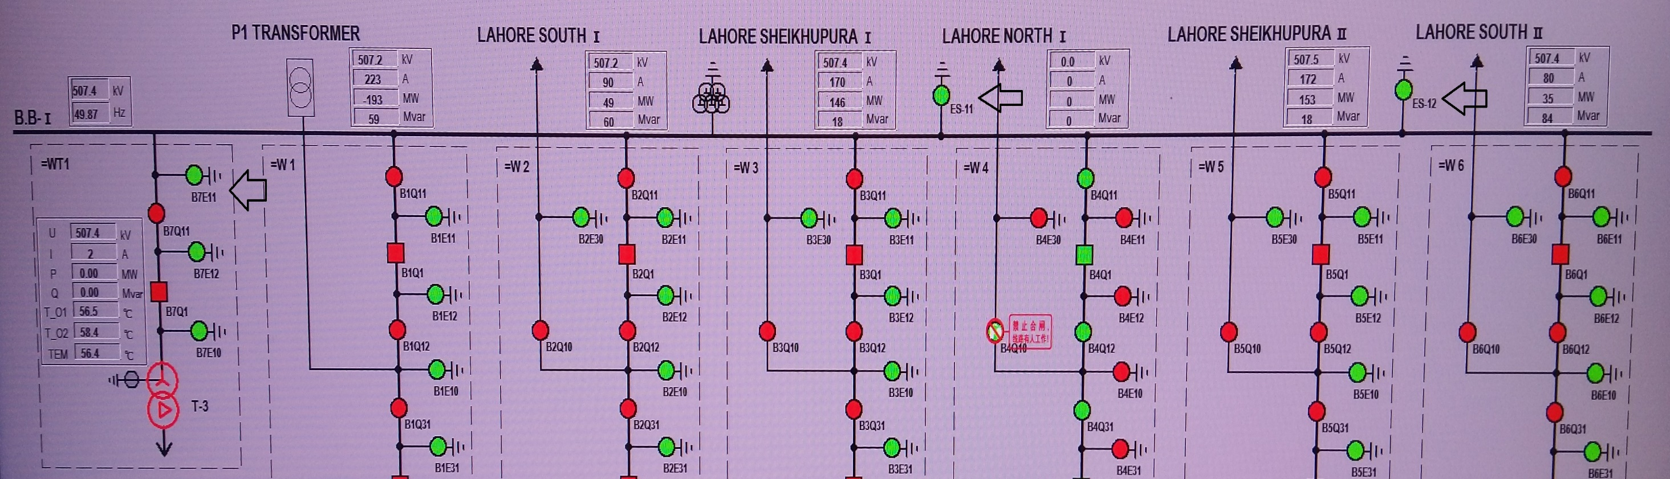
500kV BB-1 Operation:
After opening all the isolators we will now earth the BB-1. For this we will close ES-11, ES-12 and B7E11.
Interlocking for BB-1 ES to close is that the bus side breaker Q1 of all 500kV bays should be open. Bus side isolator Q11 of all the 500kV bays should be open.

Slide 15
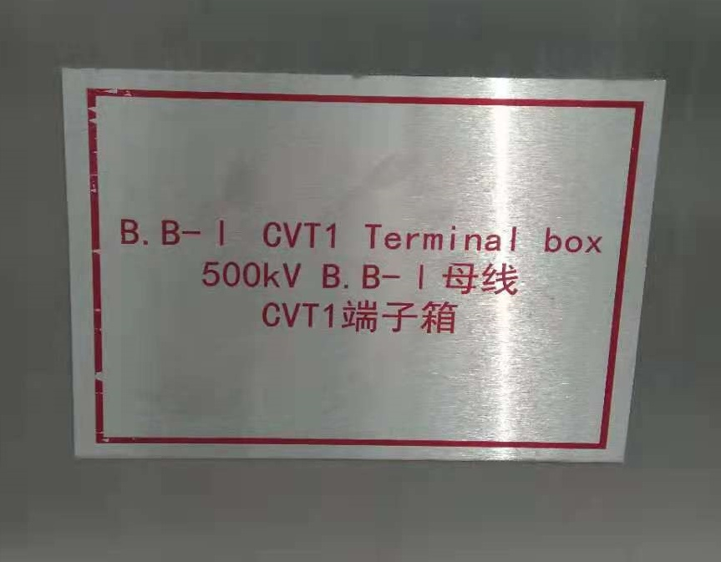
500kV BB-1 Operation:
After the bus bar is converted from cold standby to maintenance we will open the bus bar PT secondary circuit MCB from Bus PT box.

Slide 16
OPERATION SEQUENCE FOR 500/35kV T-3 STATION TRANSFORMER
MAINTENANCE

Slide 17
Considerations Before the Operation:
We can see that when we shutdown the 500/35kV T-3 station transformer there will be no effect on power transmission of 500kV outgoing lines.
The only load which will be affected by 500/35kV T-3 station transformer shutdown is the corresponding load of SPC.
So first the load should be shifted from 35kV #1M to 132/11kV T-7 transformer.

Slide 18
35kV #1M Operation:
For this purpose we will open 35/11kV T-5 transformer HV Side circuit breaker H3Q1.
As the 35kV #1M bus lose power the 11kV CB 101 will open and the 11kV BB-1 and 11kV BB-3 coupler breaker 141 will be closed automatically.
Now the load of 11kV BB-1 is been charged from 11kV BB-3 which is getting power from 132/11kV T-7 transformer.
Now we will shift the control of shunt reactor SR-1 and SR-2 from auto to manual.
If the SR-1 and SR-2 in operation we have to open the circuit breaker H1Q1 and H2Q1 in order to convert them from operation to hot standby.

Slide 19
35kV #1M Operation:

Slide 20
35kV #1M Operation:

Slide 21
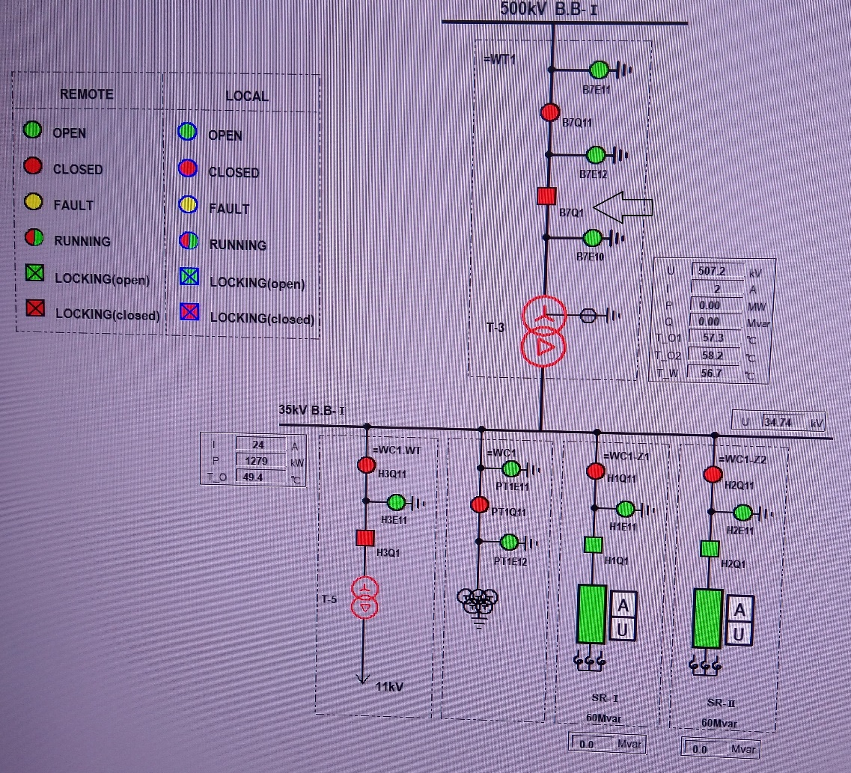
500/35kV Station Transformer T-3 HV Side Operation:
Now we will open the HV side CB B7Q1 of T-3 transformer.

Slide 22
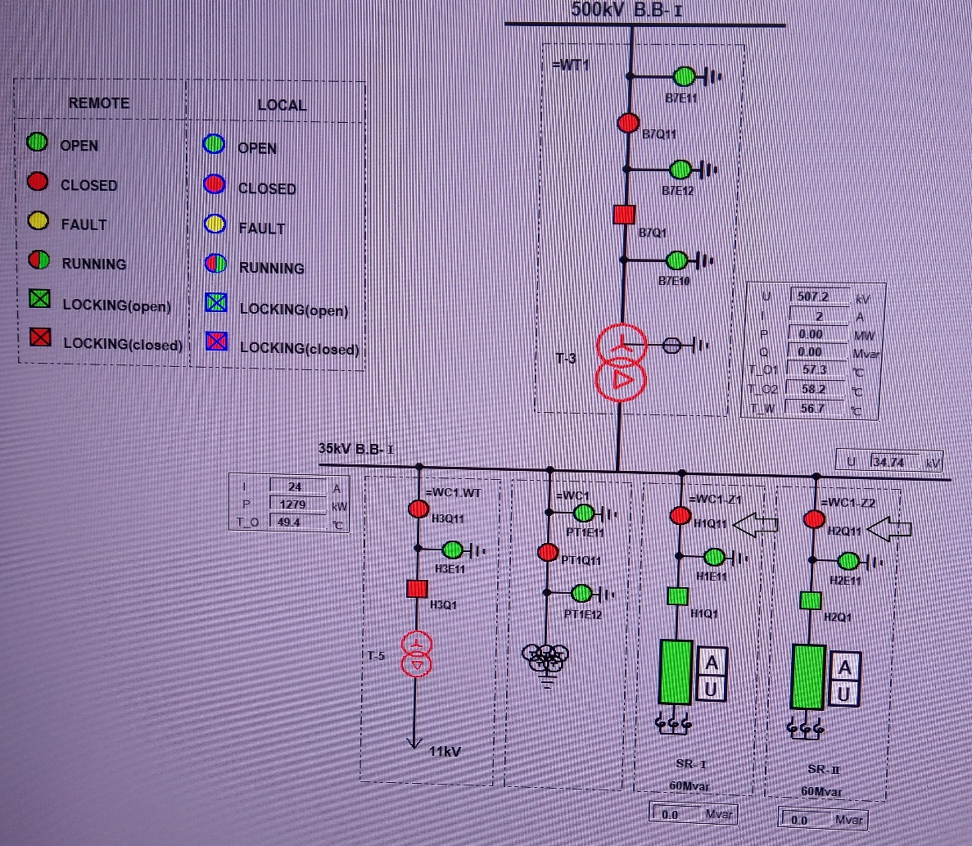
35kV #1M Operation:
Open SR-1 and SR-2 isolators H1Q11 and H2Q11 respectively.

Slide 23
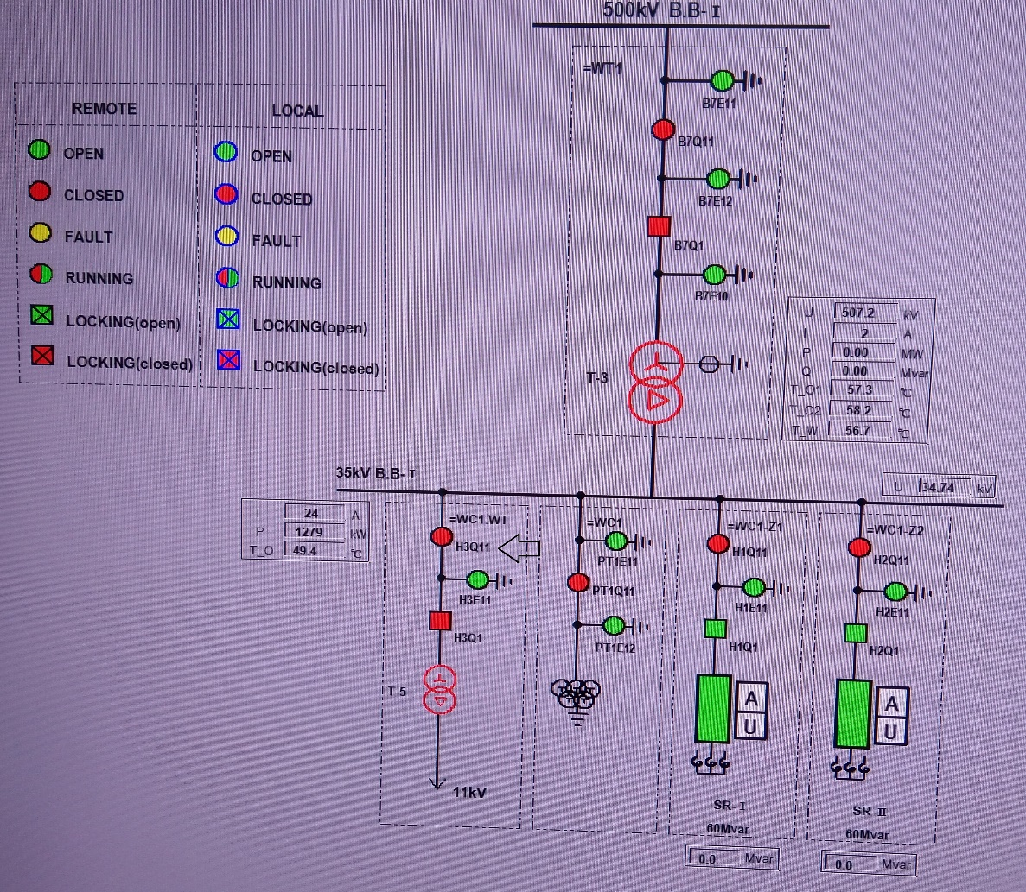
35kV #1M Operation:
Open 35/11kV T-5 transformer HV side isolator H3Q11.

Slide 24
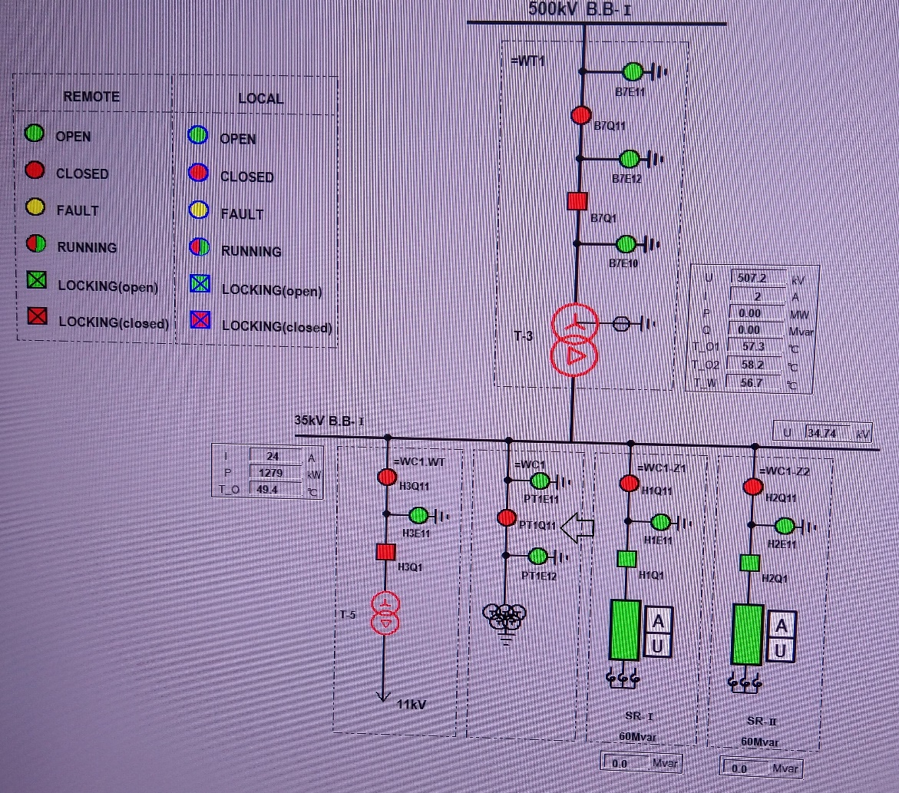
35kV #1M Operation:
Open 35kV #1M bus bar PT isolator PT1Q11.

Slide 25
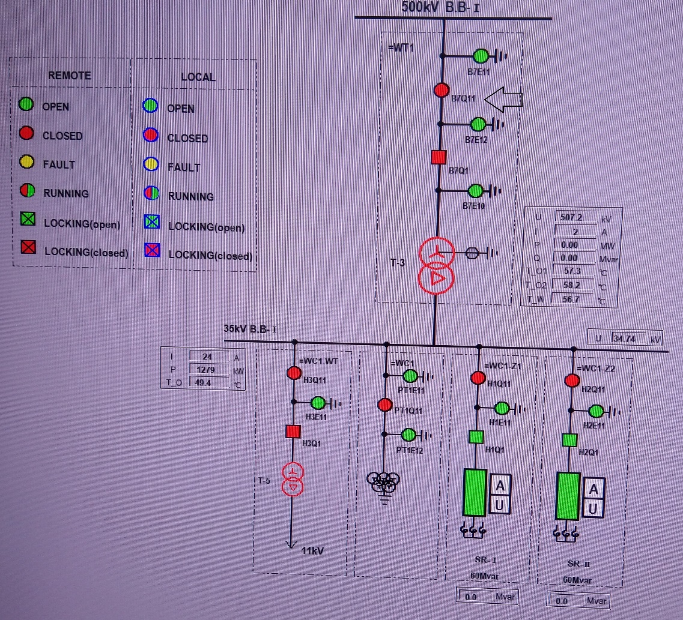
500/35kV Station Transformer T-3 HV Side Operation:
Now we will open the HV side isolator B7Q11 of T-3 transformer.

Slide 26
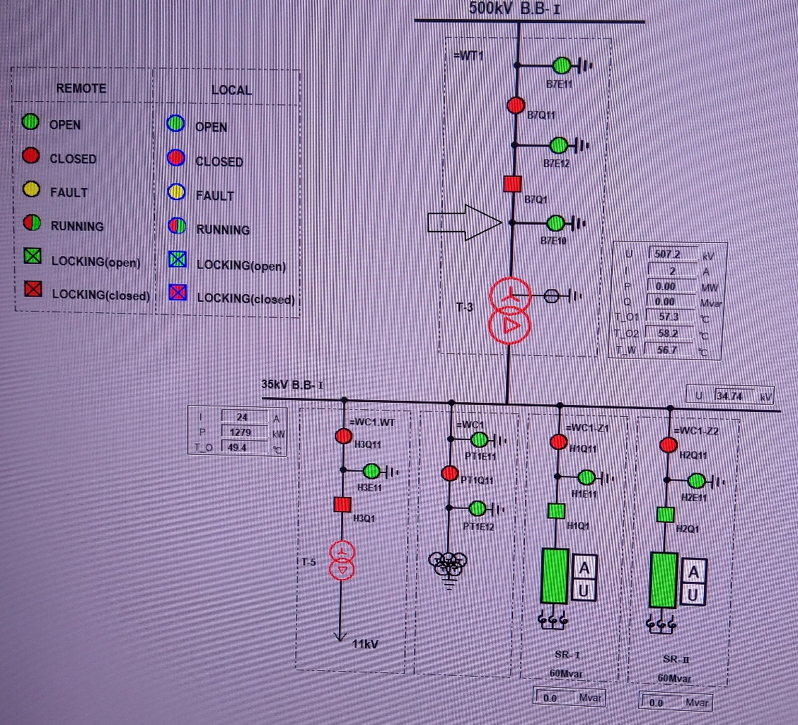
500/35kV Station Transformer T-3 HV Side Operation:
Now we will close the HV side earth switch B7E10 of T-3 transformer.

Slide 27

35kV #1M Operation:
Close 35kV #1M bus bar PT bus side earth switch PT1E11 for earthing the 35kV #1M bus bar.

Slide 28
35kV #1M Operation:
Open 35kV #1M bus bar PT secondary circuit MCB from PT box.

Slide 29
THANK YOU

